Slide 1
Data Visualisation
Guided By : Prof. Shrivatsa Perur
By : Hemanth Tubachi 2GI18IS015
Laxmi Nyamagoud 2GI18IS020
Rachana Kampli 2GI18IS032
Rohan Kokatanur 2GI18IS066

Slide 2
Introduction
Data visualization is the graphical representation of information and data.
By using visual elements like charts, graphs, and maps, data visualization tools provide an accessible way to see and understand trends, outliers, and patterns in data.
Data visualization refers to the techniques used to communicate data or information by encoding it as visual objects (e.g., points, lines or bars) contained in graphics.
The goal is to communicate information clearly and efficiently to users.

Slide 3
The Advantages & Benefits of Good Data Visualization
It can provide you some great help in:
Interpreting data better and memorable.
Noticing correlations
Figuring outliers
Feature Engineering
Cause-Effect relations
Our eyes are drawn to colors and patterns. We can quickly identify red from blue, square from circle.
Data visualization is another form of visual art that grabs our interest and keeps our eyes on the message.
When we see a chart, we quickly see trends and outliers. If we can see something, we internalize it quickly.
It’s storytelling with a purpose. If you’ve ever stared at a massive spreadsheet of data and couldn’t see a trend, you know how much more effective a visualization can be.

Slide 4
The advantages and benefits of good data visualization in terms of Data Science
Data visualization is useful for data cleaning, exploring data structure, detecting outliers and unusual groups, identifying trends and clusters, spotting local patterns, evaluating modeling output, and presenting results.
It is essential for exploratory data analysis and data mining to check data quality and to help analysts become familiar with the structure and features of the data before them.
Data Checking and Cleaning
Data Distribution
Model Assumptions
Human-in-the-Loop Analytics
Dimension Reduction

Slide 5
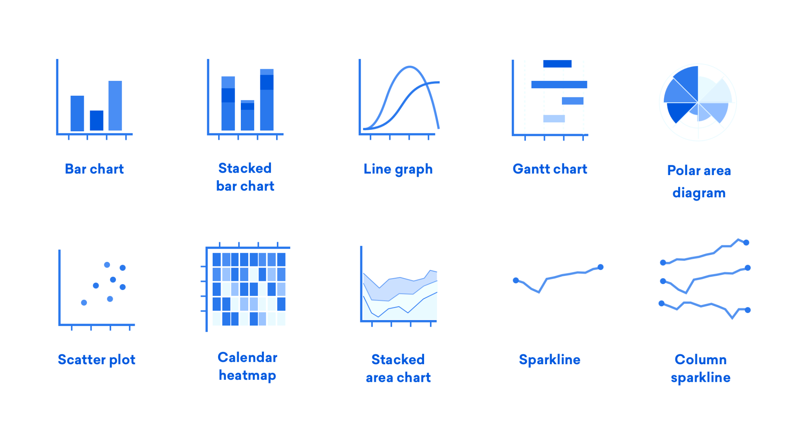
General types of Data Visualization:
Charts
Tables
Graphs
Maps
Infographics
Dashboards

Slide 6
Common Data Types
Categorical variables are the ones that don’t have any ordering e.g. Gender, Grades, Marital Status, Job Position, etc.
Numerical Variables are segmented into Ordinal and Quantitative variables.
Ordinal variables are categories that can be ranked. E.g. Satisfaction (Good, Bad, and Average), Potential (High, Medium, and Low), etc.
Quantitative variables are the ones that can take any range of numeric values between -infinity to +infinity. E.g. Age, Salary, Revenue, Sales, etc

Slide 7
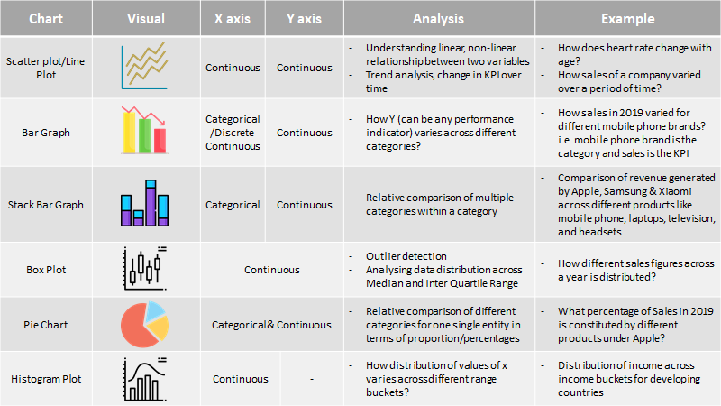
Figure illustrates how different graphs can be used to visualize patterns in the data taking into consideration the data type of the variable.

Slide 8
Conclusion
Data visualization forms the backbone of all analytical projects. It not only helps in gaining insights into the data but can be used as a tool for data pre-processing. Having the right set of visualizations for different data types and business scenarios is the key to effective communication of results.

Slide 9
Thank You

